Slide 1
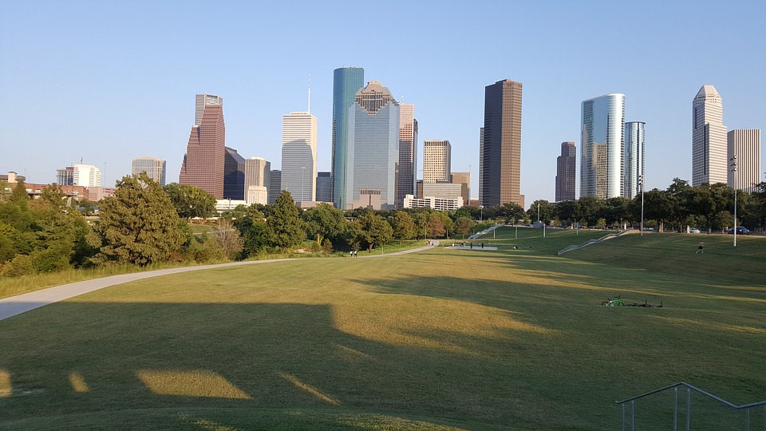
HOUSTON
A small practical guide

Slide 2
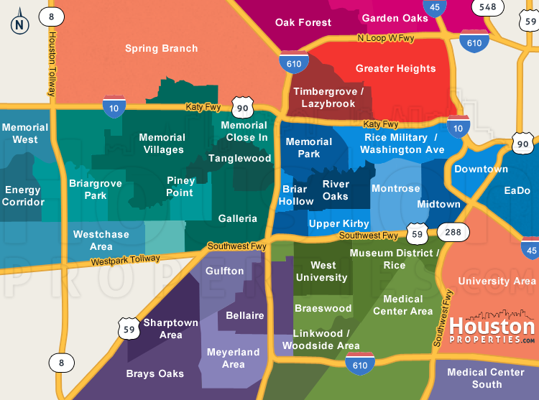
Houston at a Glance
Regroupement MLF America 2023

Slide 3
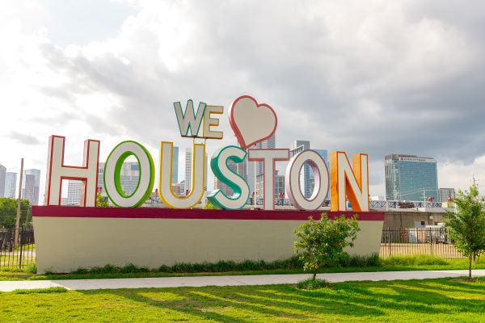
Popular Houston Restaurants
https://pappadeaux.com/home/
https://pappasbbq.com/menu/
https://pappasbros.com/home/
https://www.mortons.com/location/mortons-the-steakhouse-houston-tx-downtown/
https://www.vicandanthonys.com/location/houston/
https://www.hugosrestaurant.net/
https://ninfas.com/

Slide 4
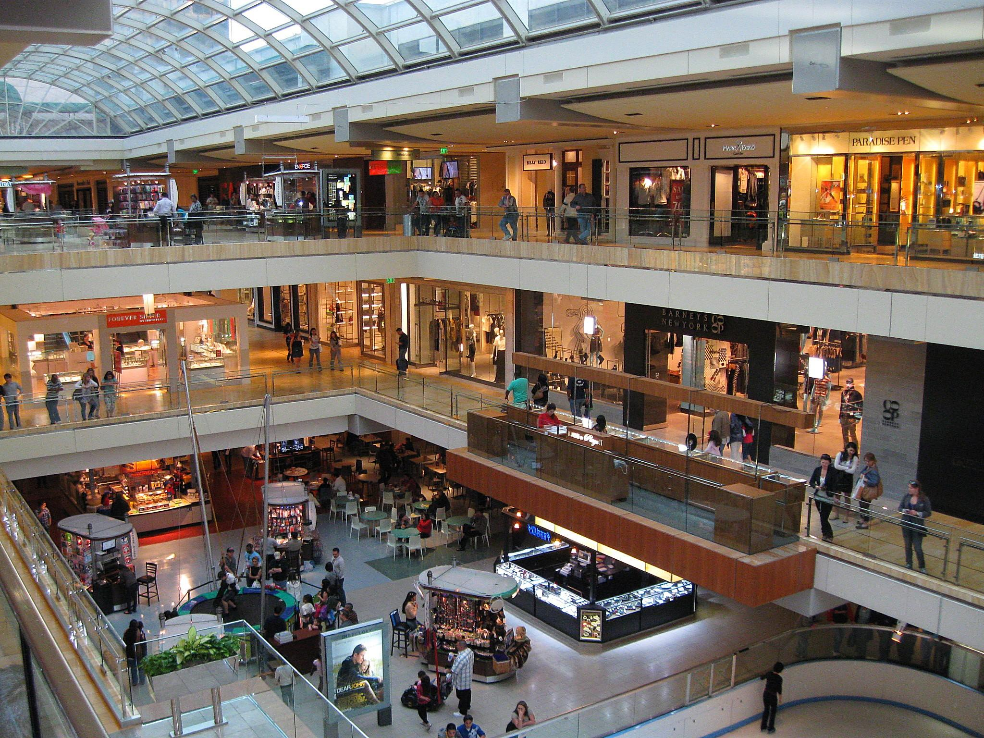
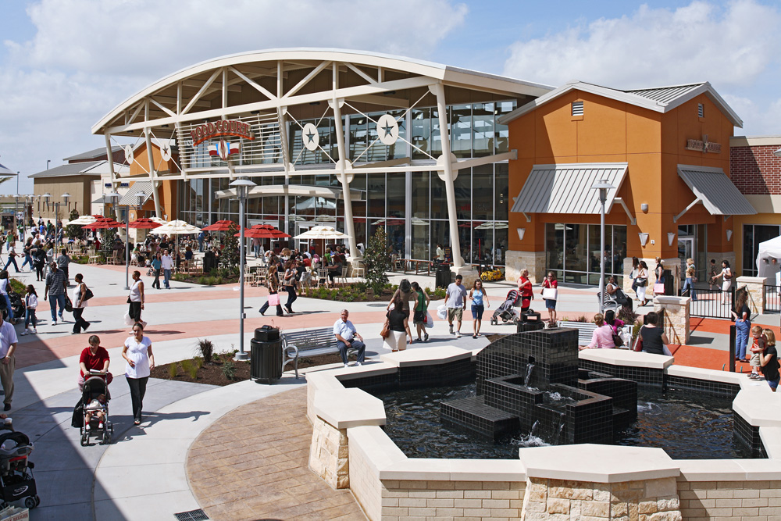
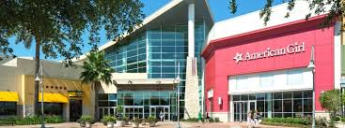
Where to shop?
The Galleria: 5 min walk, the largest mall in Texas and the 7th largest in the country, with its stores, especially luxury stores, and restaurants.
Memorial City Mall: 15-minute drive, indoor/outdoor mall.
Houston Premium Outlet: 30 minute drive to find stores at factory prices (or almost).

Slide 5
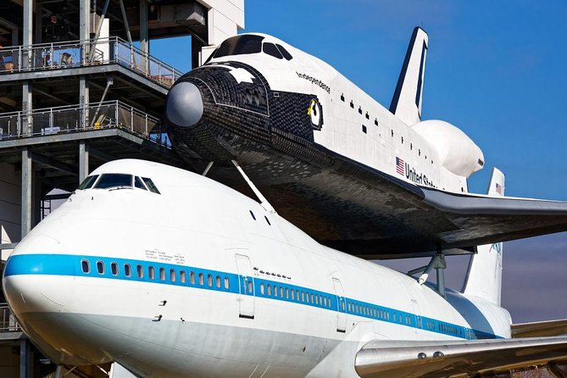
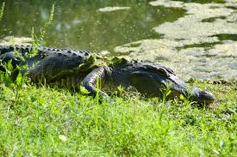
What to do in Houston?
Space Center Houston: 45 minutes by car, to learn all about NASA
The Museum District: 20 minutes by car to find the Natural History Museum, the Fine Arts Museum…
The Hermann Park Conservancy: 20 minutes by car, located next to the zoo
Brazos Bend State Park: 50 minutes drive to meet the alligators
George Ranch Historical Park: 45 minutes, to discover the life of 4 generations of the same family in Texas

Slide 6
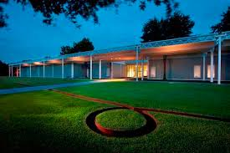
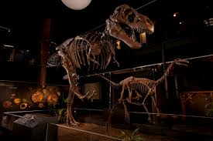
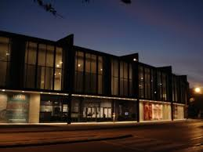
Museums:
The Museum of Fine Arts https://www.mfah.org/
The Museum of Natural Science https://www.hmns.org/
The Menil Collection https://www.menil.org/
Contemporary Arts Museum https://camh.org/

Slide 7
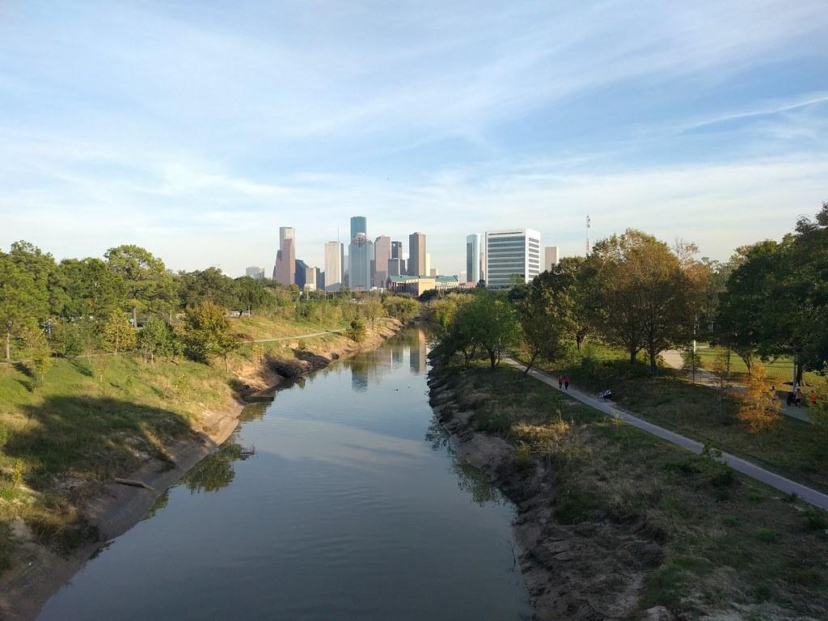
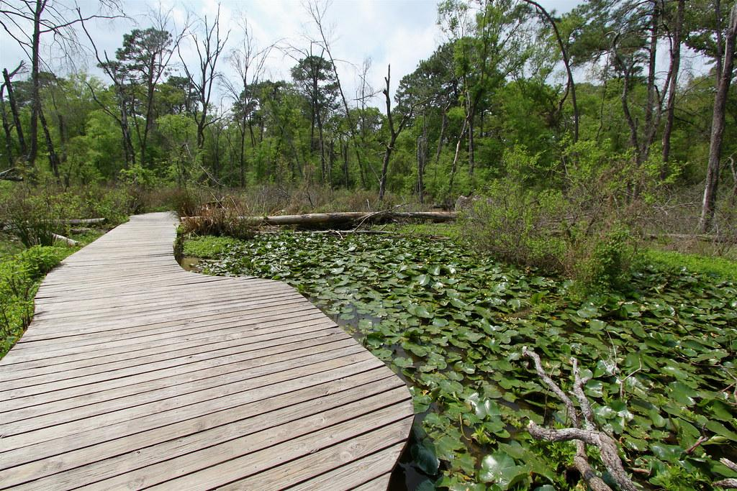
Outdoors:
Houston Arboretum and Memorial Park: 5 minutes by car
Walk or bike along the bayous:
East to Buffalo Bayou Park (15 minutes by car)
West to Terry Hershey Park Hike and Bike trail (20 minutes by car)
Try one of Houston's many golf courses

Slide 8
Sports Teams:
Astros at Minute Maid Park: 20-minute drive to rally towels with our baseball team
The Rockets at Toyota Center: 20-minute drive to hear the crunch of basketball soles on the floor of the Houston basketball court
Houston Texans Football: 25 minute drive to cheer on team
Dynamo at BBVA Compass Stadium: a 20-minute drive to see the soccer team perform

